Slide 1
Evaluation Approaches for Retrieval- Augmented Generation (RAG)
Daniel Petrov - a12028482
07 July, 2025

Slide 2
Limitations of Standalone LLMs
Hallucinations - confident presentation of factually incorrect information as the truth [6,8 - arXiv:2402.01761, arXiv:2305.14552]
Attestation bias - preference for known facts memorized during pre-training [8 - arXiv:2305.14552]
Relative frequency bias - tendency to favor statistically frequent terms (words or phrases that appear very frequently in natural language are more likely to be deemed as the truth, even if incorrect in NLI tasks) [8 - arXiv:2305.14552]
Black-box nature - difficult to trace or interpret the model's reasoning [6,8 - arXiv:2402.01761, arXiv:2305.14552]
Scaling limitations - LLMs are large (billions of parameters) and hard to steer precisely [2, 6 - arXiv:2312.05934, arXiv:2402.01761]
Static knowledge [2 - arXiv:2312.05934]
Difficult to expand and or modify [2 - arXiv:2312.05934]
Unsupervised fine-tuning - can lead to catastrophic forgetting [2 - arXiv:2312.05934]
In-context learning techniques [2 - arXiv:2312.05934]
A promising solution to these challenges: Retrieval-Augmented Generation (RAG)

Slide 3
What is RAG?
Architecture - Hybrid Design [5, 7 - arXiv:2005.11401, arXiv:2312.10997]
Combines retrieval-based methods with generative models - fully decoupled
Enables dynamic knowledge injection without the need to retrain a model
Phases [5, 7, 9 - arXiv:2005.11401, arXiv:2312.10997, arXiv:2405.07437]
Indexing
Convert documents into searchable structures (e.g., embedding vectors)
Searching
Encodes the input query into an embedding
Searches and returns the most semantically similar chunks
Augmentation
The query is augmented with the retrieved context into a prompt
Advanced strategies like CoT or Few-shot prompting
Generation
LLM generates a response conditioned on context and query
RAG mitigates the problems faced by standalone LLMs - DOES NOT FULLY solve them!

Slide 4
Why is Evaluation required?
Motivation - evaluation guides the continuous development and improvement by providing a quantifiable way to assess the performance of an RAG application [9 - arXiv:2405.07437]
Approaches
Human judgement
Automated
Naïve / surface-level (e.g ROUGE, BLUE, etc) - quick but fail to capture semantic meaning and context influence while penalizing valid rephrasings [11, 12]
Advanced (LLM-as-a-Judge) - uses configurable prompts and relies on an LLM to evaluate various aspects of an LLM application (closely aligned with human evaluation and highly scalable) [4, 9, 10 - arXiv:2309.15217, arXiv:2405.07437, arXiv:2306.05685]
Evaluation Dimensions
Retrieval - was the system able to retrieve all relevant information; was it properly ranked (Precision), is it complete (Recall) and query-relevant (Relevance)?
Generation - is the response grounded in the context (Faithfulness) and pertinent to the query (Response Relevance)?
Frameworks - Ragas, DeepEval, Opik

Slide 5
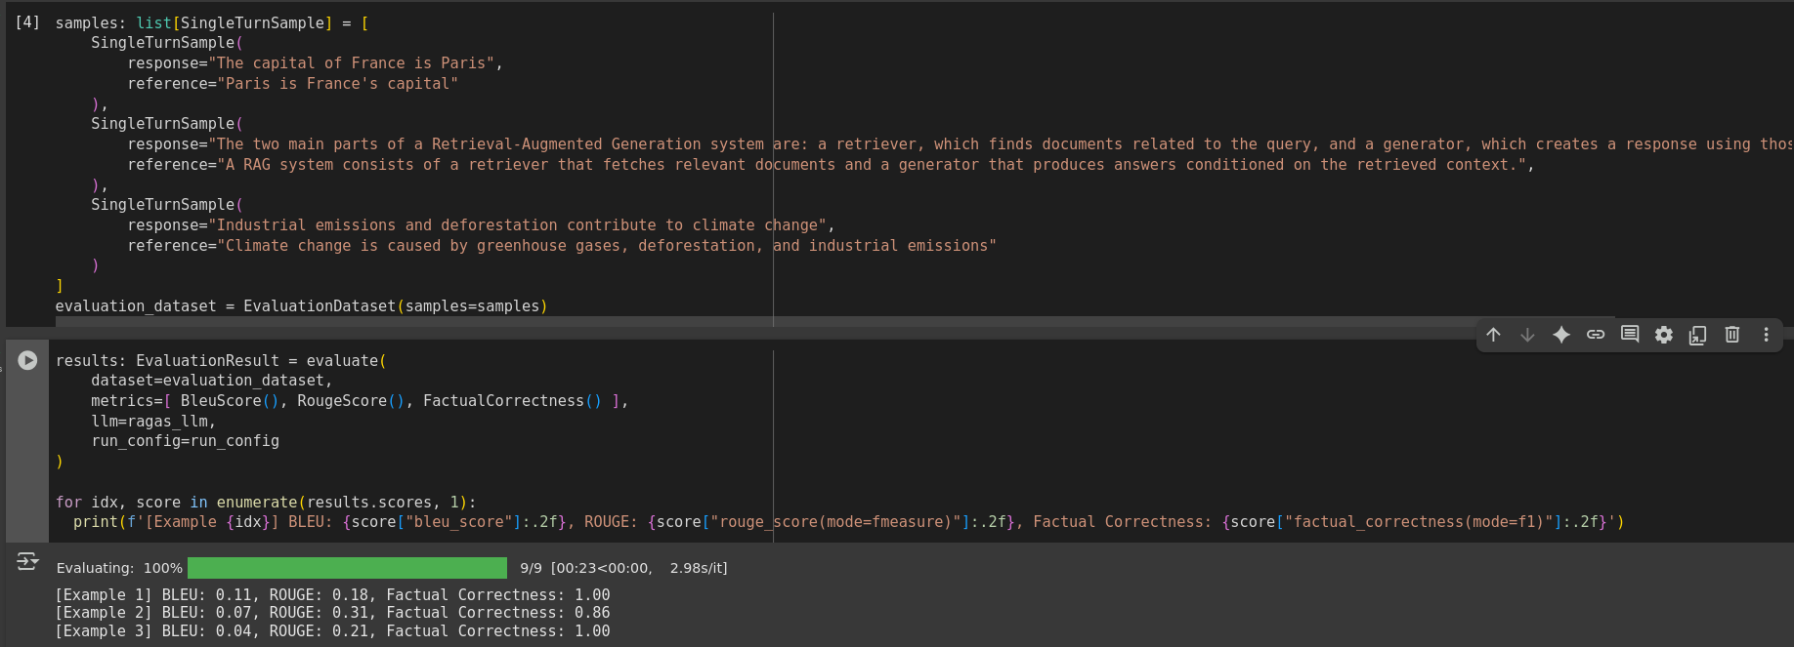
Example of Naïve Approach

Slide 6
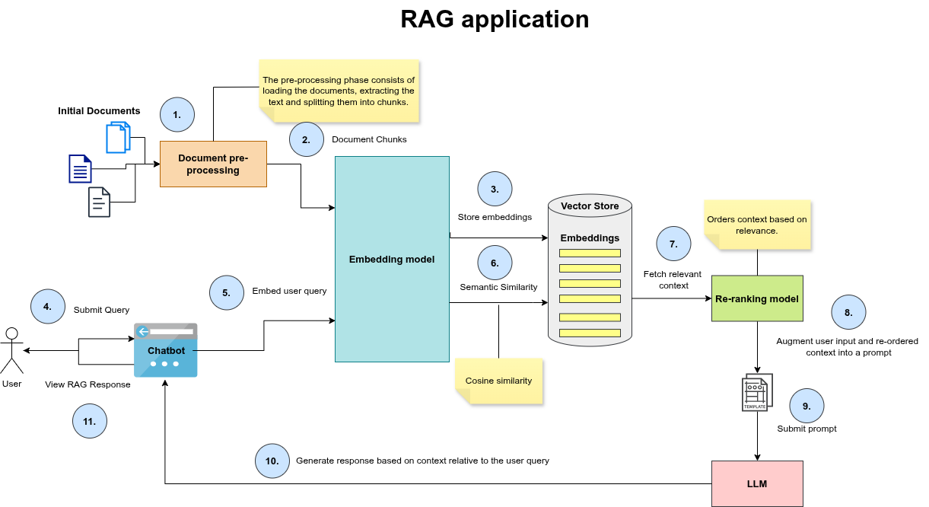
Application Architecture
You are a helpful assistant in a Retrieval-Augmented Generation (RAG) system.
Your task is to answer the user's question using *only* the provided context below.
INSTRUCTIONS:
- Answer concisely and clearly using only the information from the context.
- If the context does not contain sufficient information to answer the question, state that clearly.
- Do not speculate or make up information beyond what is in the context.
CONTEXT:
{context}
QUESTION:
{query}
ANSWER:

Slide 7

Access and Usage
Scan the QR code or visit the link:
https://github.com/danielpetrov18/Evaluation-Approaches-for-Retrieval-Augmented-Generation-RAG-
How to run the application:
Ensure you’re running it on Linux
Download the project and switch into the corresponding folder
Ensure no firewall is turned on - sudo ufw disable
Run the script in the root of the project - ./run.sh
Open http://localhost:8501 in a browser of your choice

Slide 8
Live Demo

Slide 9
Experiments
top-k | chunk size | chunk overlap | chat model
3 | 512 | 0 | llama3.1:8b
3 | 512 | 0 | llama3.1:8b-instruct-q4_1
3 | 512 | 0 | deepseek-r1:7b
5 | 768 | 64 | llama3.1:8b
5 | 768 | 64 | llama3.1:8b-instruct-q4_1
5 | 1024 | 128 | llama3.1:8b
5 | 1024 | 128 | llama3.1:8b (RAG fusion)
5 | 1024 | 128 | llama3.1:8b-instruct-q4_1
5 | 1024 | 128 | deepseek-r1:7b
10 | 2048 | 256 | llama3.1:8b

Slide 10
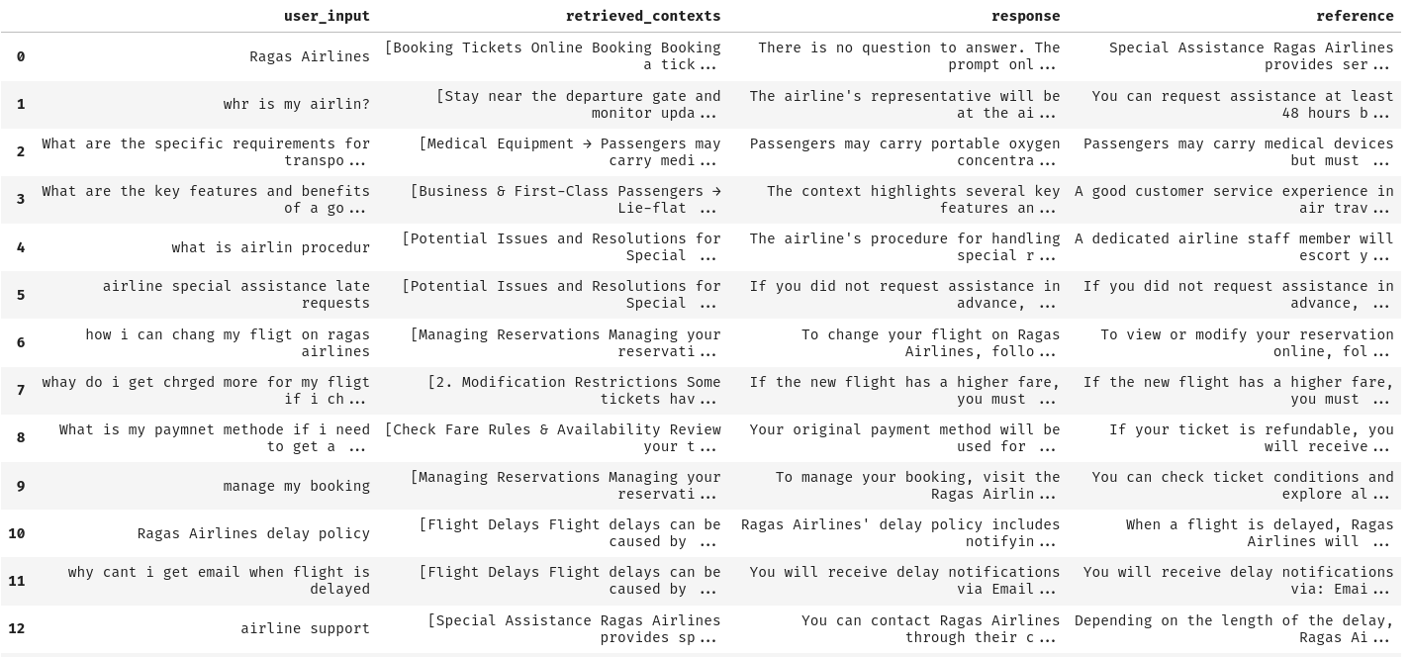
Evaluation Datasets

Slide 11





Metrics
Context Precision
Context Recall
Retrieval
user_input
response
retrieved_contexts
reference
Generation
Answer Relevancy
Faithfulness

Slide 12
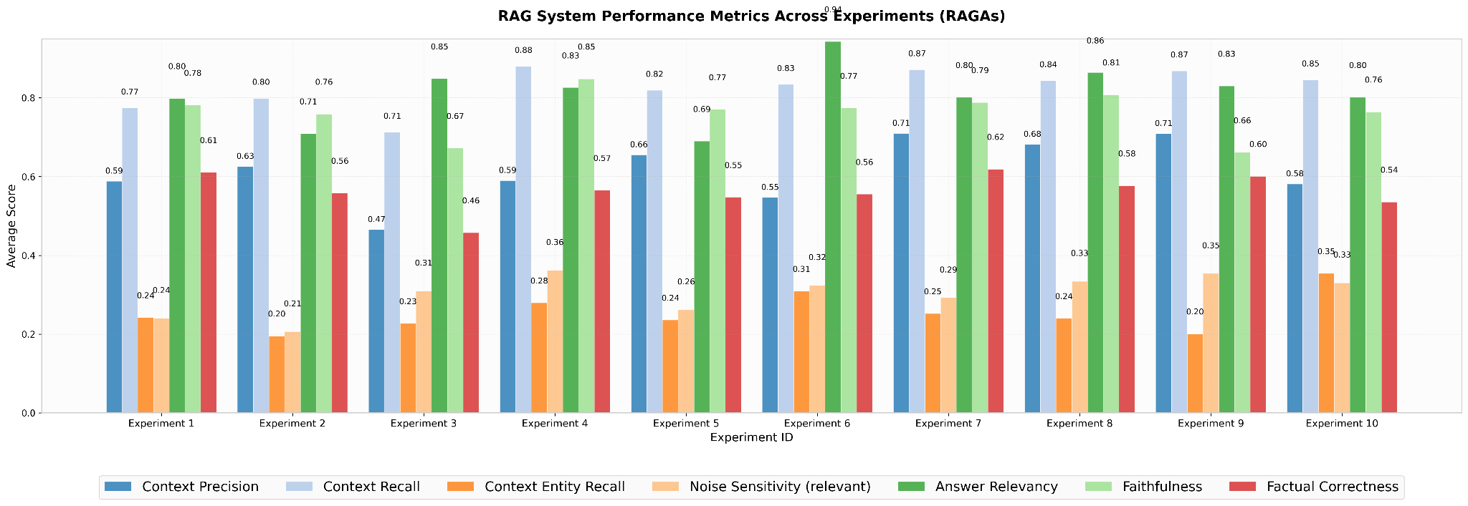

Slide 13
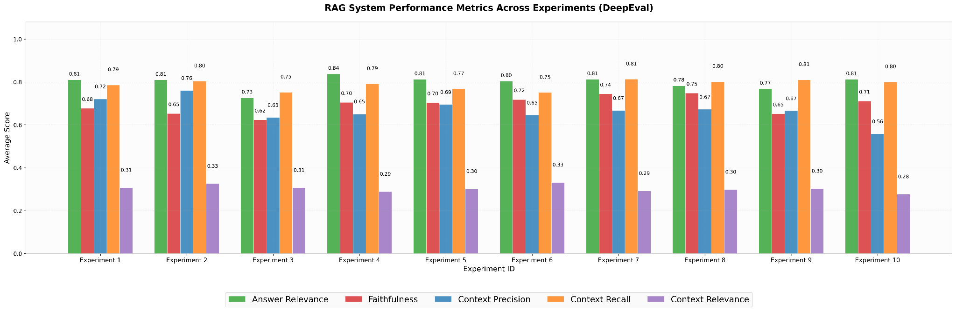

Slide 14
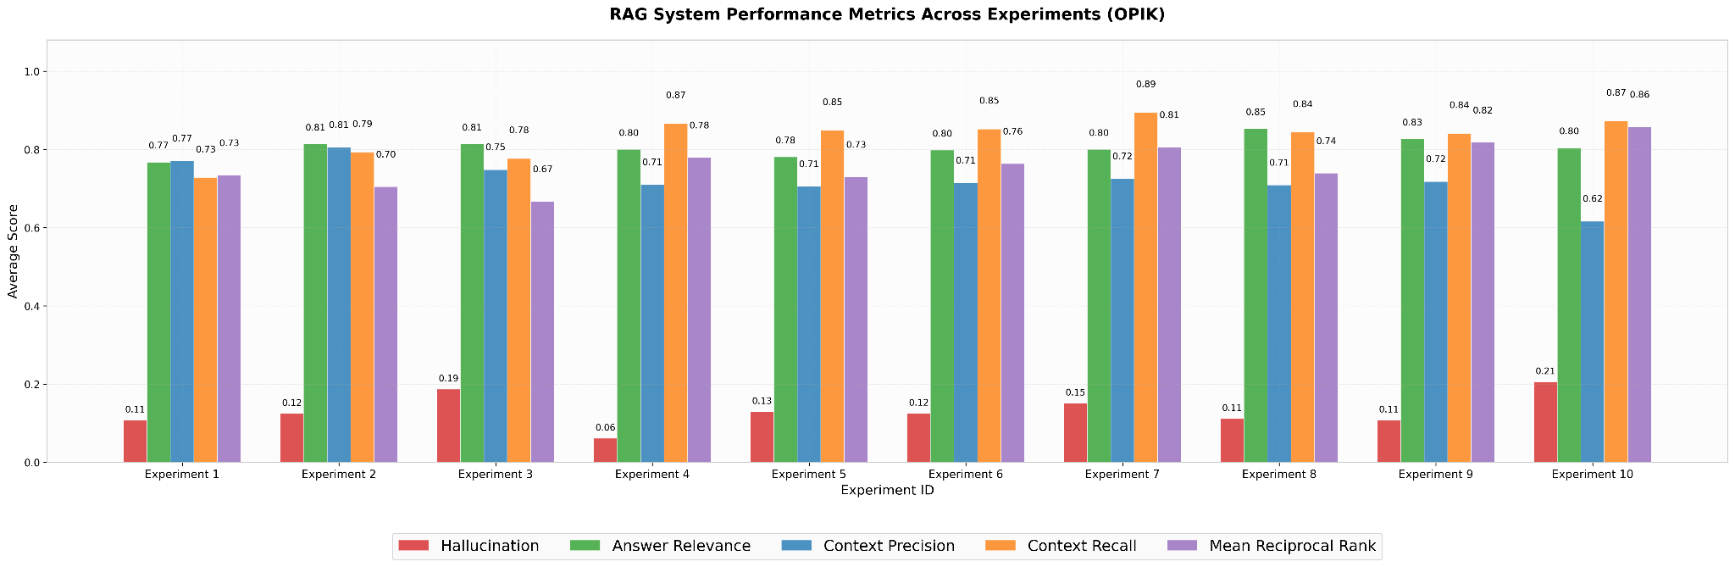

Slide 15
Conclusion
Evaluation is mandatory for assessing the quality of a RAG application
An iterative process where trial and error leads to the best possible configuration
Still a developing field
Using LLM-as-a-judge is not cost effective (token usage)
High-quality models are required for proper evaluation
Large Language Model can suffer from self-preference bias which can negatively impact the evaluation process
Prompt engineering is non-trivial
In critical applications (e.g. medical, legal) human oversight still required

Slide 16
Sources
R. T. de Lima et al. (2024). Know Your RAG: Dataset Taxonomy and Generation Strategies for Evaluating RAG Systems. arXiv:2411.19710
O. Ovadia et al. (2023). Fine‑Tuning or Retrieval? Comparing Knowledge Injection in LLMs. arXiv:2312.05934
N. F. Liu et al. (2023). Lost in the Middle: How Language Models Use Long Contexts. arXiv:2307.03172
S. Es et al. (2023). RAGas: Automated Evaluation of Retrieval Augmented Generation. arXiv:2309.15217
P. Lewis et al. (2020). Retrieval‑Augmented Generation for Knowledge‑Intensive NLP Tasks. arXiv:2005.11401
Ch. Singh et al. (2024). Rethinking Interpretability in the Era of Large Language Models. arXiv:2402.01761
Y. Gao et al. (2023). Retrieval‑Augmented Generation for Large Language Models. arXiv:2312.10997
N. McKenna et al. (2023). Sources of Hallucination by Large Language Models on Inference Tasks. arXiv:2305.14552
H. Yu et al. (2024). Evaluation of Retrieval‑Augmented Generation: A Survey. arXiv:2405.07437
L. Zheng et al. (2023). Judging LLM‑as‑a‑Judge with MT‑Bench and Chatbot Arena. arXiv:2306.05685
Milvus (2024). Which traditional language‑generation metrics are applicable for evaluating RAG‑generated answers and what aspect of quality does each (BLEU, ROUGE, METEOR) capture. URL: https://milvus.io/ai-quick-reference/which-traditional-language-generation-metrics-are-applicable-for-evaluating-raggenerated-answers-and-what-aspect-of-quality-does-each-bleu-rouge-meteor-capture
Ramachandran (2023). LLM Evaluation Metrics: RAG Offline Metrics – MRR, nDCG, ROUGE, BLEU. URL: https://medium.com/@ramachandran1985/llm-evaluation-metrics-rag-offline-metrics-mrr-ndcg-rouge-bleu-1145761da900
RAGas documentation. URL: https://docs.ragas.io/en/stable/
DeepEval documentation. URL: https://deepeval.com/docs/getting-started
Comet Opik documentation. URL: https://www.comet.com/docs/opik/

Slide 17
Questions?
Thank you!

